Slide 1

MAXIMIZING STOCK PORTFOLIO GROWTH IN
US MARKET
PRESENTED BY: PINYO / REBECCA / ETHAN

Slide 2

TOPIC
PROJECT APPROACH
DATA COLLECTION
KPI MEASUREMENT APPROACH

Slide 3

PROJEC
APPROACH

Slide 4
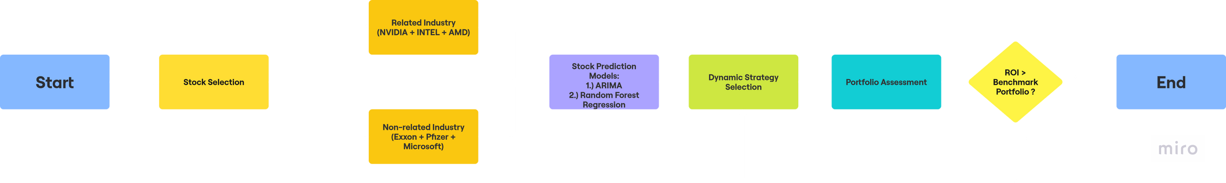
OVERVIEW

Slide 5
PREDICTION MODELS
Model Selection Criteria:
Suitable for non-linear
Work well for short period prediction
Less sensitive to outlier
Avoid overfitting situation

Slide 6
PREDICTION MODELS
ARIMA
RANDOM FOREST REGRESSION
XGBOOST

Slide 7
DATA
COLLECTION

Slide 8
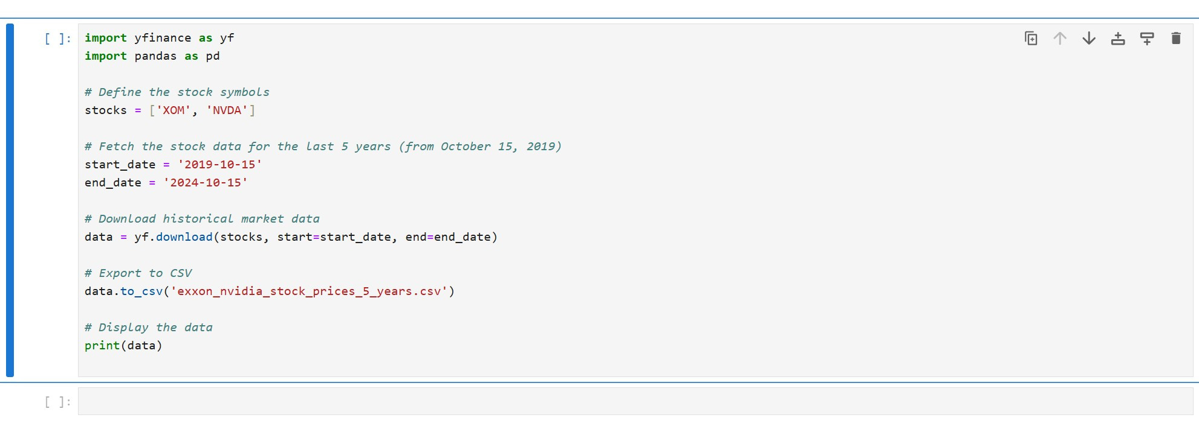
DATA COLLECTION

Slide 9
KPI
MEASUREMENT

Slide 10





OUR KPI
The key performance indicator (KPI) is to compare different investment ratios by allocating one-third of the portfolio across three different stocks.
REALLYGREATSITE.COM

Slide 11

CRYPTO COIN
THANKS FOR LISTENING
REALLYGREATSITE.COM

